Slide 1
CS118 – Programming Fundamentals
Lecture # 16
Monday, October 21, 2019
FALL 2019
FAST – NUCES, Faisalabad Campus
Course instructor:
Ebad Majeed
Slides Credit:
Rizwan Ul Haq

Slide 2
Objectives
In this week/classes, you will:
Learn about standard (predefined) functions and discover how to use them in a program
Learn about user-defined functions
Examine value-returning functions, including actual and formal parameters
Explore how to construct and use a value-returning, user-defined function in a program

Slide 3
Modular Programming
Modular programming: Breaking a program up into smaller, manageable functions or modules
Function: A collection of statements to perform a task
Motivation for modular programming
Improves maintainability of programs
Simplifies the process of writing programs

Slide 4
Introduction
Boss to worker analogy
A boss (the calling function or caller) asks a worker (the called function) to perform a task and return (i.e., report back) the results when the task is done

Slide 5
Introduction
Functions are like building blocks
They allow complicated programs to be divided into manageable pieces
Some advantages of functions:
A programmer can focus on just that part of the program and construct it, debug it, and perfect it
Different people can work on different functions simultaneously
Can be re-used (even in different programs)
Enhance program readability

Slide 6
Introduction (cont'd.)
Functions
Called modules
Like miniature programs
Can be put together to form a larger program

Slide 7
Predefined Functions
In algebra, a function is defined as a rule or correspondence between values, called the function’s arguments, and the unique value of the function associated with the arguments
If f(x) = 2x + 5, then f(1) = 7, f(2) = 9, and f(3) = 11
1, 2, and 3 are arguments
7, 9, and 11 are the corresponding values

Slide 8
Predefined Functions (cont'd.)
Some of the predefined mathematical functions are:
sqrt(x);
sqrt( 4 );
sqrt( 3 - 6x );
pow(x, y);
floor(x);
Predefined functions are organized into separate libraries
I/O functions are in iostream header
Math functions are in cmath/math header

Slide 9
Predefined Functions (cont'd.)
pow(x,y) calculates x^{y}
pow(2, 3) = 8.0
Returns a value of type double
x and y are the parameters (or arguments)
This function has two parameters
sqrt(x) calculates the nonnegative square root of x, for x >= 0.0
sqrt(2.25) is 1.5
Type double

Slide 10
Predefined Functions (cont'd.)
The floor function floor(x) calculates largest whole number not greater than x
floor(48.79) is 48.0
Type double
Has only one parameter

Slide 11
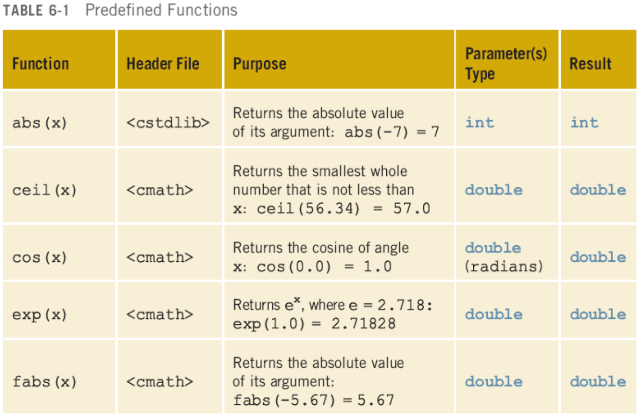
Predefined Functions (cont'd.)

Slide 12
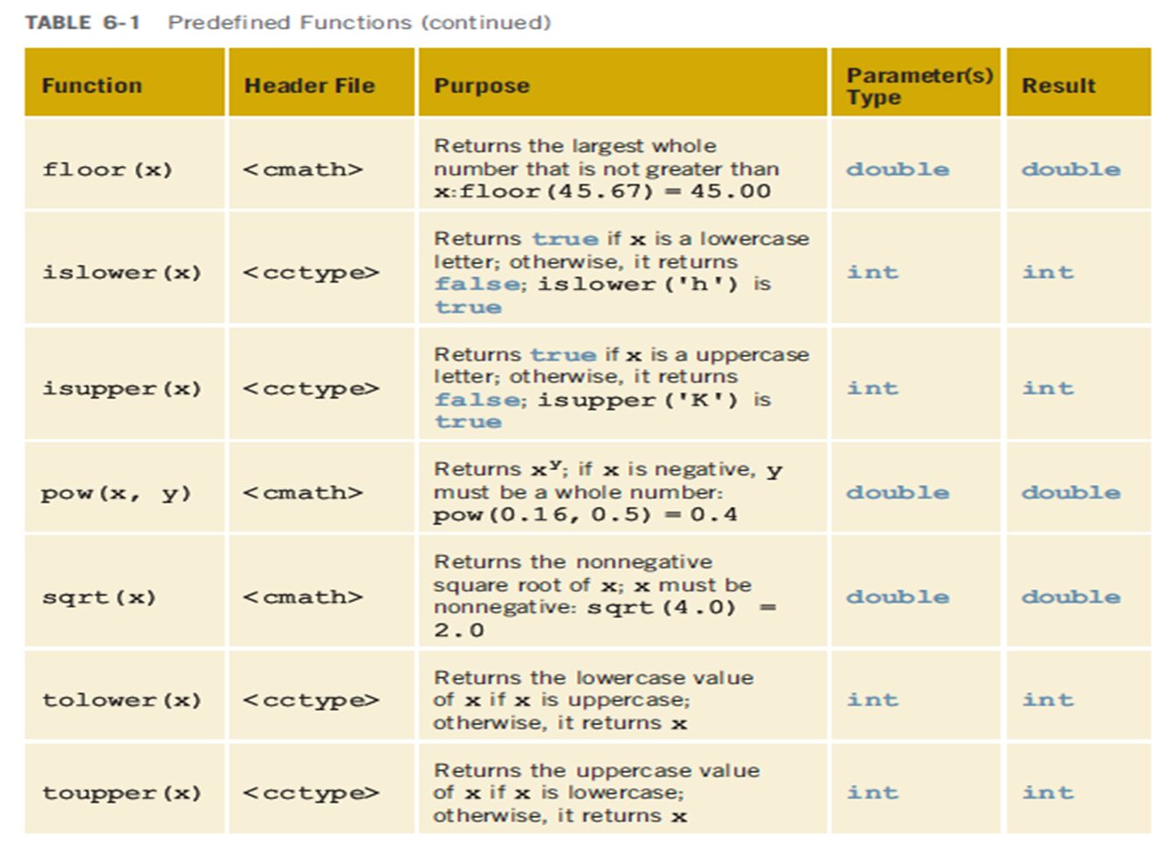
Predefined Functions (cont'd.)

Slide 13
Predefined Functions (cont'd.)
Example 6-1
//How to use predefined function
#include <iostream>
#include <cmath>
#include <cctype>
#include <cstdlib>
using namespace std;
int main(){
int x;
double u, v;
cout << "Line 1: Uppercase a is “
<< static_cast<char> (toupper('a'))
<< endl; //Line 1
u = 4.2 ; //Line 2
v = 3.0 ; //Line 3
cout << "Line 4: " << u << " to the power of “
<< v << " = " << pow(u,v) << endl; //Line 4
cout << "Line 5 : 5.0 to the power of 4 = "
<< pow(5.0,4) << endl; //Line 5
u = u + pow(3.0, 3); //Line 6
cout << "Line 7: u = " << u << endl; //Line 7
x = -15 ; //Line 8
cout << "Line 9: Absolute value of " << x
<< " = " << abs(x) << endl; //Line 9
return 0;
}

Slide 14
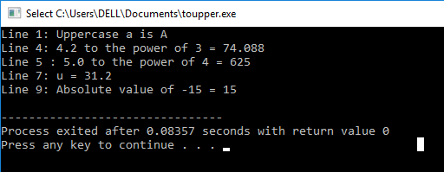
Predefined Functions (cont'd.)
Example 6-1 sample run:

Slide 15
User-Defined Functions
Value-returning functions: have a return type
Return a value of a specific data type using the return statement function, called the type of the function
You need to add the following items :
The name of the function
The number of parameters, if any
The data type of each parameter
The data type of the value computed (that is, the value returned) by the Function
Void functions: do not have a return type
Do not use a return statement to return a value

Slide 16
Function Return Type
If a function returns a value, the type of the value must be indicated
int main()
If a function does not return a value, its return type is void
void printHeading()
{
cout << "\tMonthly Sales\n";
}

Slide 17
Defining and Calling Functions
Function call: Statement that causes a function to execute
Function definition: Statements that make up a function
int abs(int number);
Similarly the function abs might have the following definition:
int abs(int number)
{
if(number < 0)
number = -number;
return number;
}

Slide 18
Function Definition
Definition includes
return type: Data type of the value the function returns to the part of the program that called it
name: Name of the function. Function names follow same rules as variable names
parameter list: Variables that hold the values passed to the function
body: Statements that perform the function’s task

Slide 19
Syntax: Value-Returning function
functionType functionName(formal parameter list)
{
statements
}

Slide 20
Syntax: Formal Parameter List
Function Return Type
Function name
Function parameter
Formal Heading
int abs(int number) { if(number<0) number=-number;
return number; }
Formal parameter list
Formal Body

Slide 21
Syntax: Actual Parameter List
Can be zero parameter

Slide 22
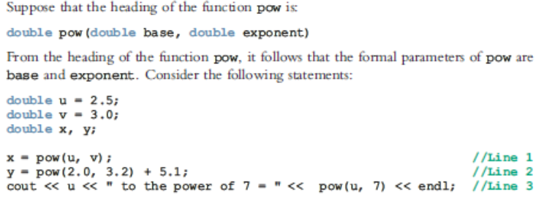
Actual Parameter Vs Formal Parameter

Slide 23
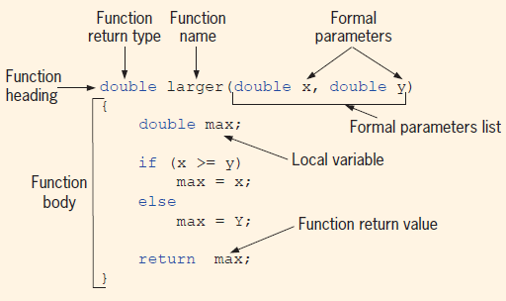
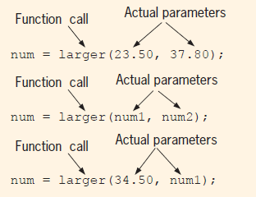

Slide 24
Function Header
The function header consists of
the function return type
the function name
the function parameter list
Example:
int main()

Slide 25
Calling a Function
To call a function, use the function name followed by () and ;
printHeading();
When a function is called, the program executes the body of the function
After the function terminates, execution resumes in the calling function at the point of call
main() is automatically called when the program starts
main() can call any number of functions
Functions can call other functions

Slide 26
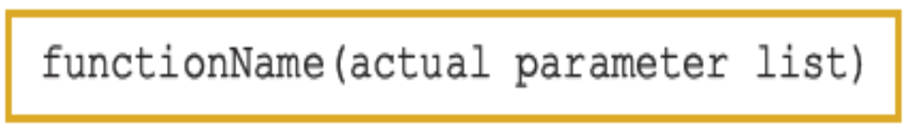
Function Call

Slide 27
Function Call Notes
Value of argument is copied into parameter when the function is called
Function can have >= 0 parameter(s)
There must be a data type listed in the prototype () and an argument declaration in the function heading () for each parameter
Arguments will be promoted/demoted as necessary to match parameters

Slide 28
Calling Functions with Multiple Arguments
When calling a function with multiple arguments:
The number of arguments in the call must match the function prototype and definition
The first argument will be copied into the first parameter, the second argument into the second parameter, etc.

Slide 29
Calling Functions with Multiple Arguments – an Illustration
displayData(height, weight); //Call
void displayData(int h, int w) //heading
{
cout << "Height = " << h << endl;
cout << "Weight = " << w << endl;
}

Slide 30
Value-Returning Functions -- Example
int abs(int number)
{
if(number < 0)
number = -number;
return number;
}

Slide 31
return Statement
Once a value-returning function computes the value, the function returns this value via the return statement
It passes this value outside the function via the return statement

Slide 32
Syntax: return Statement
The return statement has the following syntax:
In C++, return is a reserved word
When a return statement executes
Function immediately terminates
Control goes back to the caller
When a return statement executes in the function main, the program terminates
e.g return 0;

Slide 33
Returning a Value From a Function
return statement can be used to return a value from the function to the module that made the function call
Prototype and definition must indicate data type of return value (not void)
Calling function should use return value
assign it to a variable
send it to cout
use it in an arithmetic computation
use it in a relational expression
Pass it as a parameter to another function

Slide 34
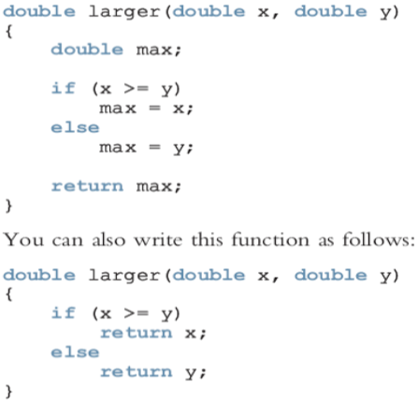
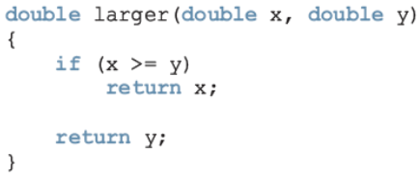
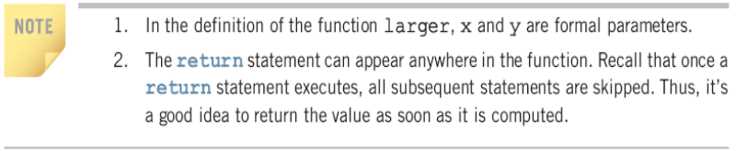
Syntax: return Statement (cont’d.)

Slide 35
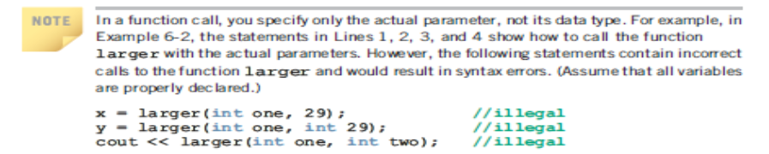
Example

Slide 36
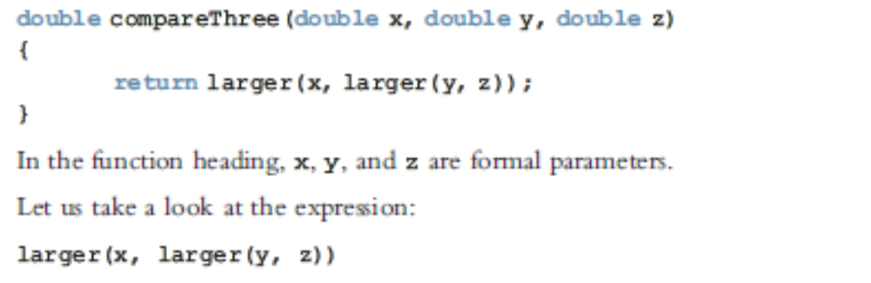
Function to compare three numbers

Slide 37
Returning a Boolean Value
Function can return true or false
Declare return type in function prototype and heading as bool
Function body must contain return statement(s) that return true or false
Calling function can use return value in a relational expression

Slide 38
Boolean return Example
bool isValid(int); // prototype
bool isValid(int val) // heading
{
int min = 0, max = 100;
if (val >= min && val <= max)
return true;
else
return false;
}
if (isValid(score)) // call
…

Slide 39
Function Prototypes
The compiler must know the following about a function before it is called
name
return type
number of parameters
data type of each parameter

Slide 40
Function Prototype
Function prototype: Function heading without the body of the function
Syntax:
It is not necessary to specify the variable name in the parameter list
The data type of each parameter must be specified

Slide 41
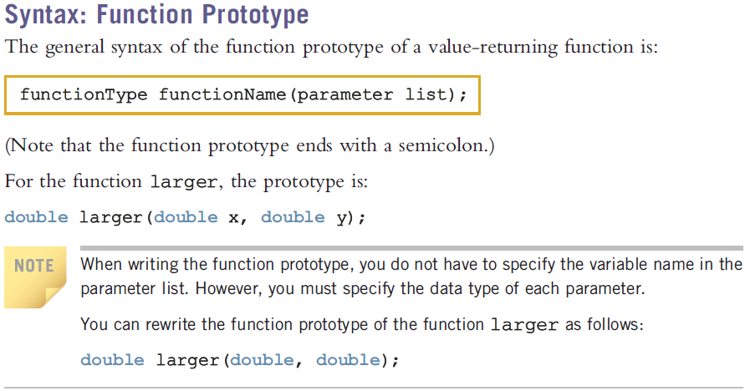
Function Prototype
The function heading without the body of the function.

Slide 42
Prototype Notes
Place prototypes near top of program
Program must include either prototype or full function definition before any call to the function, otherwise a compiler error occurs
When using prototypes, function definitions can be placed in any order in the source file. Traditionally, main is placed first.
Use a function prototype (similar to the heading of the function
Heading: void printHeading()
Prototype: void printHeading();

Slide 43
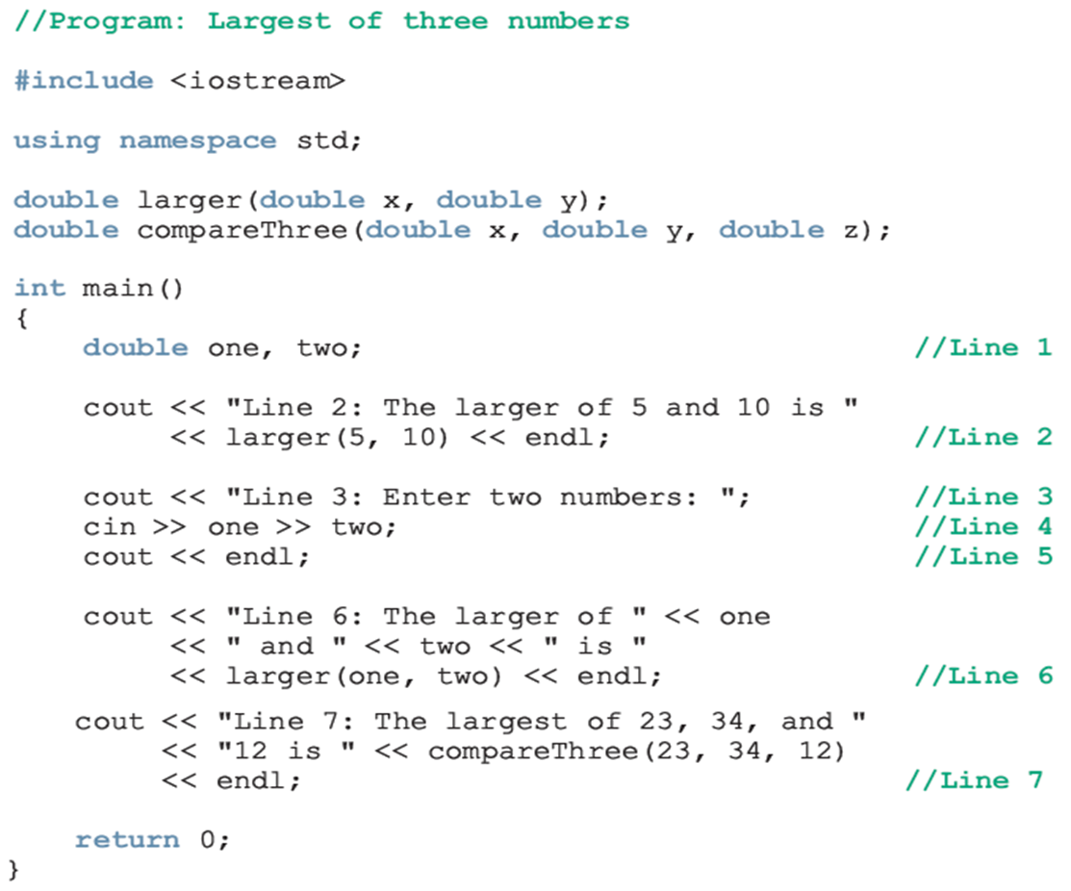
Function Prototype (Illustration)

Slide 44
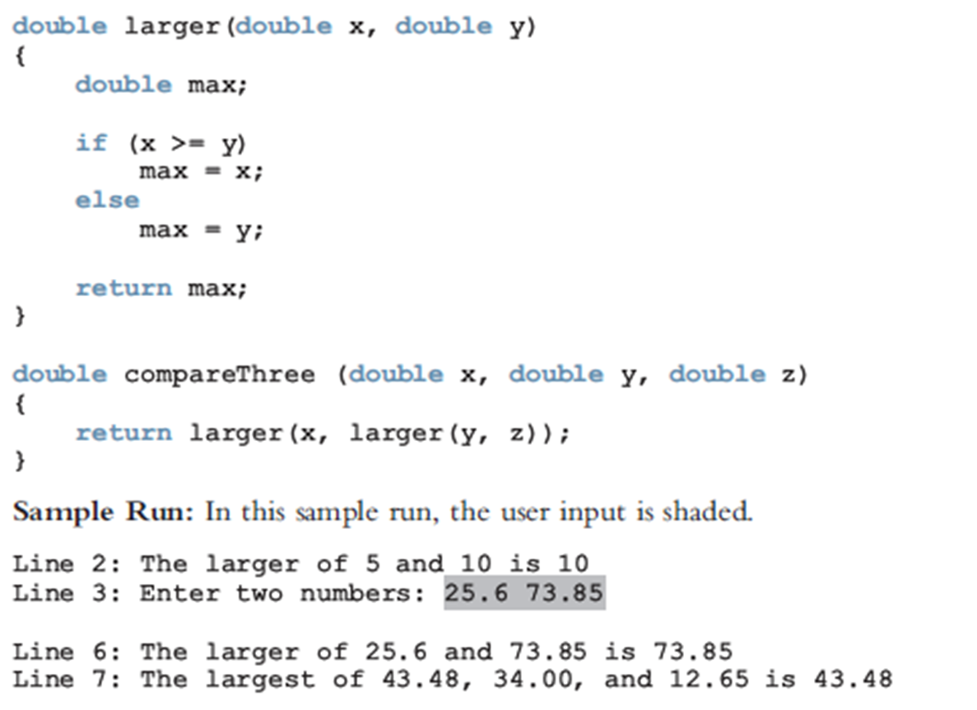
Function Prototype (Illustration cont'd.)

Slide 45
Example Program I
1 // C++ Program
2 // Creating and using a programmer-defined function.
3 #include <iostream>
4
5 using std::cout;
6 using std::endl;
7
8 int square( int ); // function prototype
9
10 int main()
11 {
12 // loop 10 times and calculate and output
13 // square of x each time
14 for ( int x = 1; x <= 10; x++ )
15 cout << square( x ) << " "; // function call
16
17 cout << endl;
18
19 return 0; // indicates successful termination
20
21 } // end main
22
23 // square function definition returns square of an integer
24 int square( int y ) // y is a copy of argument to function
25 {
26 return y * y; // returns square of y as an int
27
28 } // end function square
Function prototype: specifies data types of arguments and return values. square expects and int, and returns an int.
Parentheses () cause function to be called. When done, it returns the result.
Definition of square. y is a copy of the argument passed. Returns y * y, or y squared.

Slide 46
Output
1 4 9 16 25 36 49 64 81 100

Slide 47
Example Program II
1 // C ++ Program
2 // Finding the maximum of three floating-point numbers.
3 #include <iostream>
4
5 using std::cout;
6 using std::cin;
7 using std::endl;
8
9 double maximum( double, double, double ); // function prototype
10
11 int main()
12 {
13 double number1;
14 double number2;
15 double number3;
16
17 cout << "Enter three floating-point numbers: ";
18 cin >> number1 >> number2 >> number3;
19
20 // number1, number2 and number3 are arguments to
21 // the maximum function call
22 cout << "Maximum is: "
23 << maximum( number1, number2, number3 ) << endl;
24
25 return 0; // indicates successful termination
26
27 } // end main
28
Function maximum takes 3 arguments (all double) and returns a double.

Slide 48
Example Program II
Comma separated list for multiple parameters.
29 // function maximum definition;
30 // x, y and z are parameters
31 double maximum( double x, double y, double z )
32 {
33 double max = x; // assume x is largest
34
35 if ( y > max ) // if y is larger,
36 max = y; // assign y to max
37
38 if ( z > max ) // if z is larger,
39 max = z; // assign z to max
40
41 return max; // max is largest value
42
43 } // end function maximum

Slide 49
Enter three floating-point numbers: 99.32 37.3 27.1928
Maximum is: 99.32
Enter three floating-point numbers: 1.1 3.333 2.22
Maximum is: 3.333
Enter three floating-point numbers: 27.9 14.31 88.99
Maximum is: 88.99

Slide 50

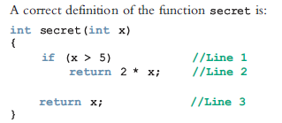
Value-Returning Functions: Some Peculiarity

Slide 51
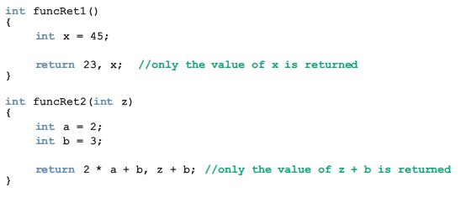
Value-Returning Functions: Some Peculiarity (cont'd.)

Slide 52
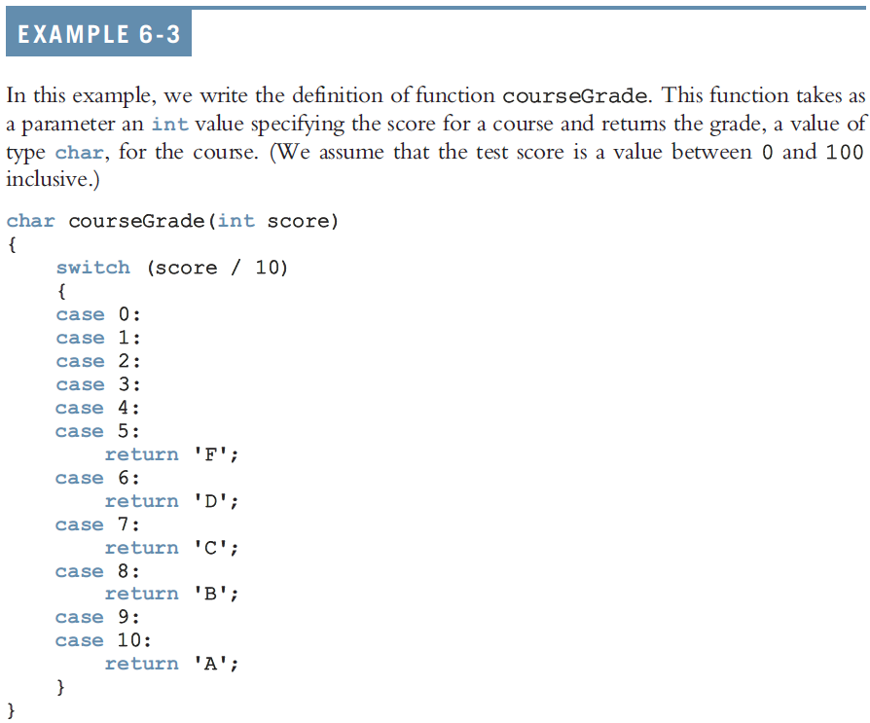
Value-Returning Functions: Some Peculiarity (cont'd.)

Slide 53
Questions

